Slide 1
Building Apps for Continuum Developer’s Guide to Windows 10 Build 10586 SDK Update
Andy Wigley Liz Threlkeld
@andy_wigley @liz_threlkeld

Slide 2
Introducing Continuum

Slide 3
Continuum
Two apps run simultaneously on two screens
Windows Apps transition seamlessly and look beautiful on any screen
Keyboard and mouse support

Slide 4


Slide 5
Demo: Continuum
Notes:
Open outlook
Sales doc
Send text

Slide 6
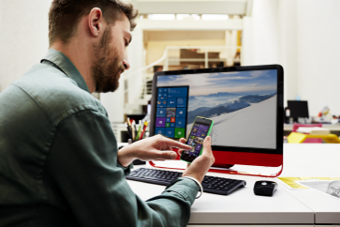
Developer considerations
Hardware
Adaptive Apps
Packaging
Scaling
Multi-screen
Integral

Slide 7
Developer considerations
Hardware
Adaptive Apps
Packaging
Scaling
Multi-screen
Integral

Slide 8
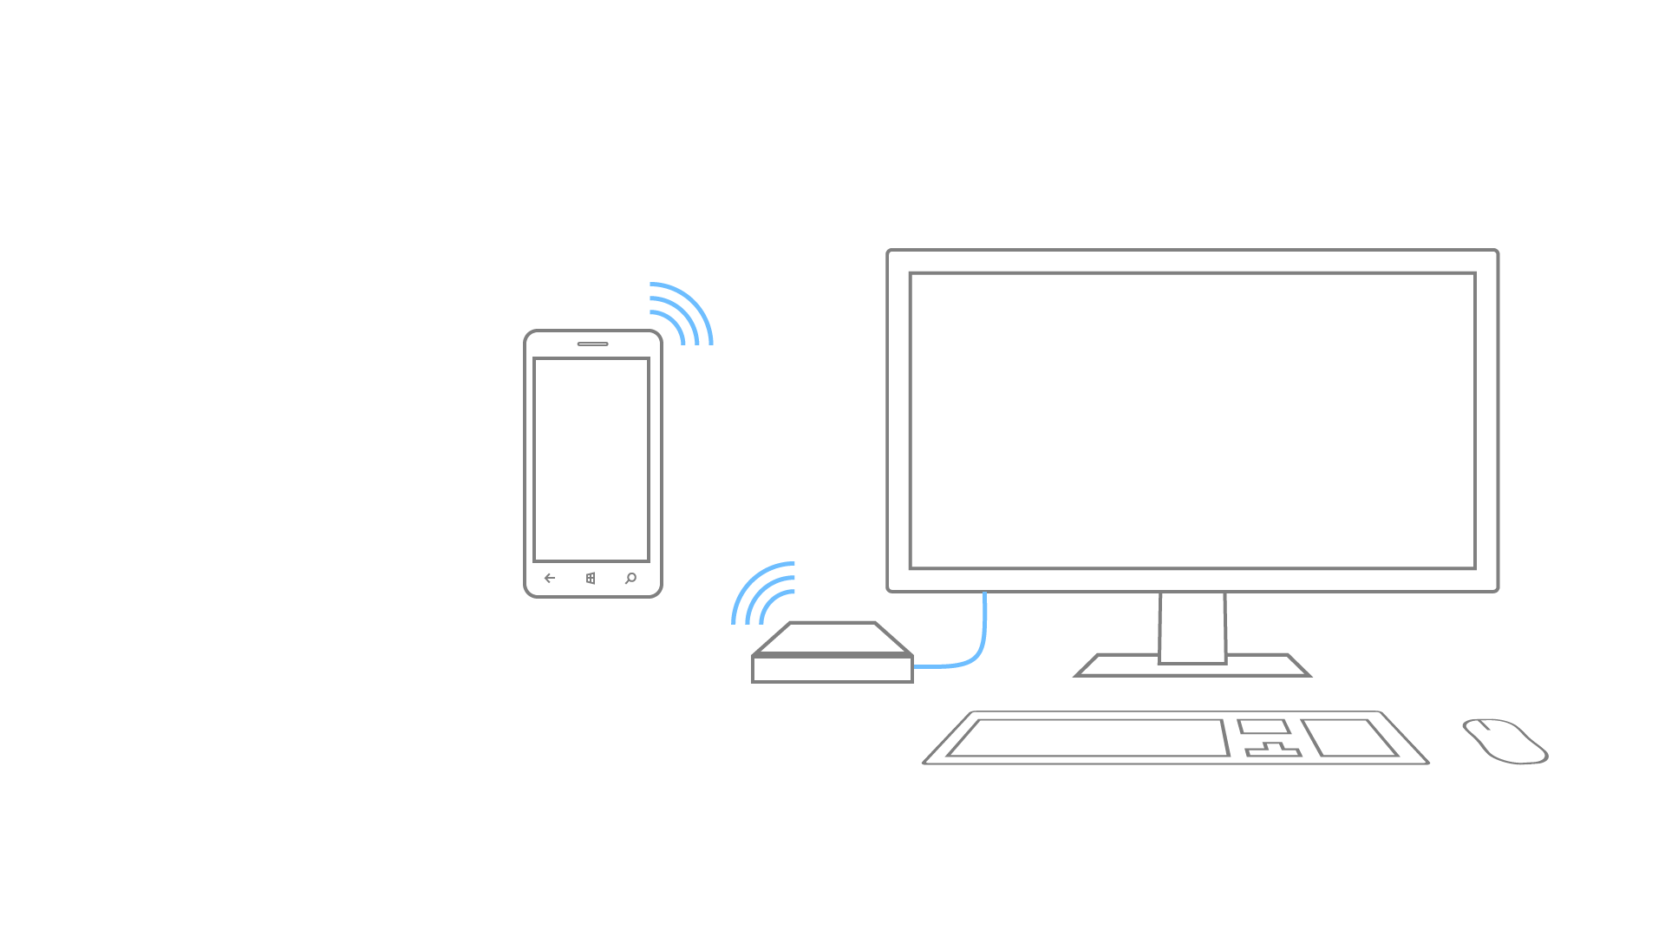
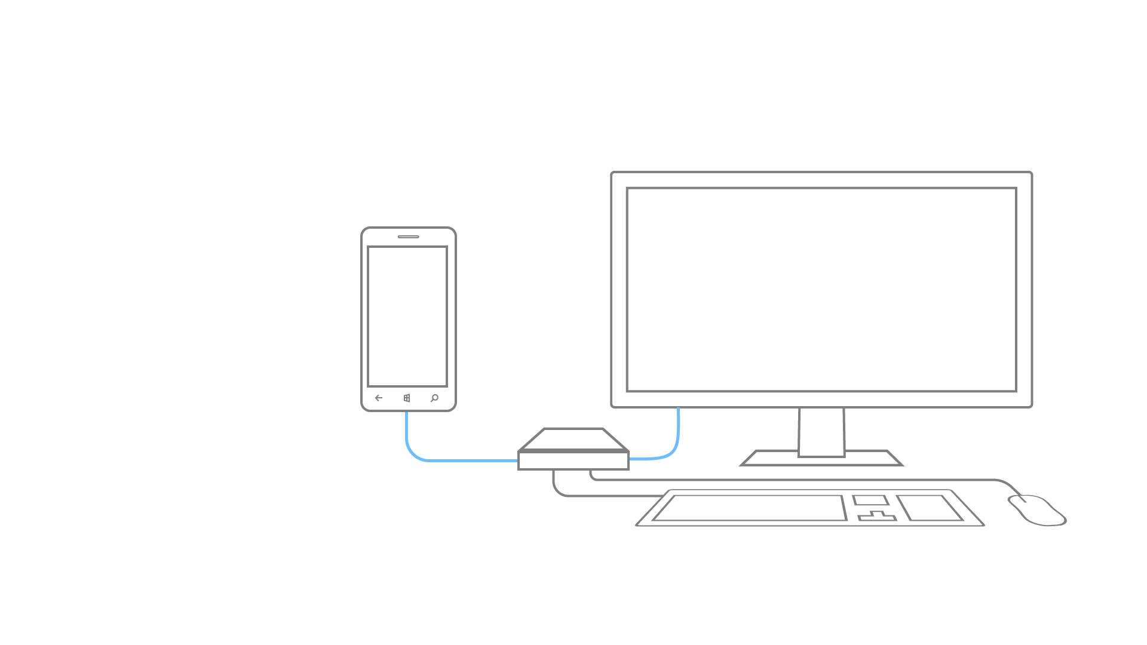
Wired dock
Wireless dock

Slide 9
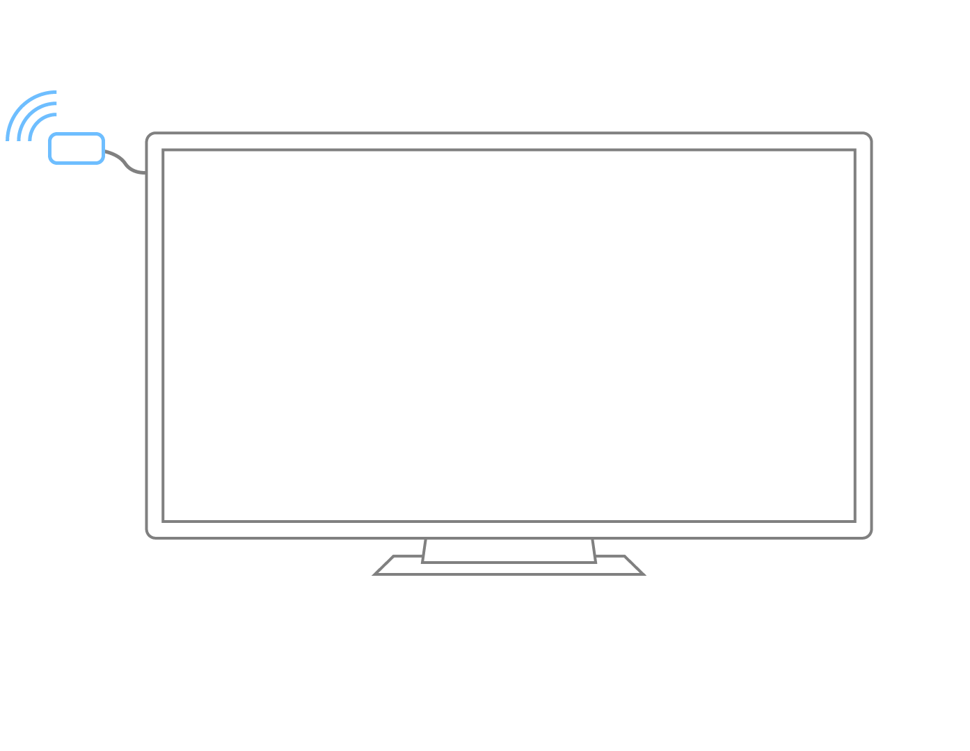
Wireless dongle

Slide 10
Users will interact with your app on a big screen with keyboard and mouse.

Slide 11
Developer considerations
Hardware
Adaptive Apps
Packaging
Scaling
Multi-screen
Integral

Slide 12
How does Continuum affect UI design?
For UWP, connected screen is just another screen size
Standard adaptive UI techniques apply
Primary Display
5”
8”
13”
Secondary Display
Phone
Viewing Distance: 16.3”
Tablets and 2 in 1
Viewing Distance:
20”
Small and Large Laptops
Viewing Distance:
24.5”
Secondary Display
Small and Large Desktop Monitors
Viewing Distance:
28”
TV
Viewing Distance:
84”

Slide 13
Adaptive Triggers
Connected Screen
<VisualState>
<!-- VisualState to be triggered when window width is >768 effective pixel-->
<VisualState.StateTriggers>
<AdaptiveTrigger MinWindowWidth=“800" />
</VisualState.StateTriggers>
<VisualState.Setters>
<Setter Target="Button1.Content” Value="Wide"/> </VisualState.Setters>
</VisualState>
<VisualState>
<!-- VisualState to be triggered when window width is between 0 to 768 effective pixels-->
<VisualState.StateTriggers>
<AdaptiveTrigger MinWindowWidth="0" />
</VisualState.StateTriggers>
<VisualState.Setters>
<Setter Target="Button1.Content” Value="Narrow"/> </VisualState.Setters>
</VisualState>
Internal Screen

Slide 14
UserInteractionMode API
public MainPage()
{
InitializeComponent();
Window.Current.SizeChanged += SizeChanged;
}
private void SizeChanged(object sender, RoutedEventArgs e)
{
switch(UIViewSettings.GetForCurrentView().UserInteractionMode)
{
case UserInteractionMode.Mouse:
VisualStateManager.GoToState(this, "MouseLayout", true);
break;
// When touch is returned, use touch-optimized layout
case UserInteractionMode.Touch:
default:
VisualStateManager.GoToState(this, "TouchLayout", true);
break;
}
}
}

Slide 15
Demo: Adaptive UI with Continuum
Notes:
show VS adaptive app on phone, move to external display

Slide 16
Refinement: Optimize for user input method
The most optimal UI also adjusts layout when user is using Touch or Mouse+Keyboard
Phone display: Touch
Connected display: Mouse + Keyboard
Desktop in PC mode: Mouse + Keyboard
Desktop in Tablet mode: Touch
For Touch, may wish to increase spacing between input elements to allow for easier activation through bigger touch targets

Slide 17


Input intelligence built into standard controls

Slide 18
If creating separate pages for different screens, switch on screen size, not device family

Slide 19
Navigating to screen size-specific views
using Windows.Graphics.Display;
…
//Get the diagonal size of the integrated display
double _actualSizeInInches = Double.MaxValue;
if (DisplayInformation.GetForCurrentView().DiagonalSizeInInches.HasValue)
_actualSizeInInches = DisplayInformation.GetForCurrentView().DiagonalSizeInInches.Value;
//If the diagonal size is <= 7" use the OneHanded optimized view
if ( _actualSizeInInches > 0 && _actualSizeInInches <= 7)
{
rootFrame.Navigate(typeof(MainPage_OneHanded), e.Arguments);
}
else
{
rootFrame.Navigate(typeof(MainPage), e.Arguments);
}
Notes:
point: navigating to specific page based on size rather than device family

Slide 20
Developer considerations
Hardware
Adaptive Apps
Packaging
Scaling
Multi-screen
Integral

Slide 21
If you build an adaptive Windows App, and make it available on Windows 10 Mobile , it will work on Continuum

Slide 22
Opting out of the connected display
<Package
xmlns="http://schemas.microsoft.com/appx/manifest/foundation/windows10"
xmlns:mp="http://schemas.microsoft.com/appx/2014/phone/manifest"
xmlns:uap="http://schemas.microsoft.com/appx/manifest/uap/windows10"
xmlns:mobile="http://schemas.microsoft.com/appx/manifest/mobile/windows10"
IgnorableNamespaces="uap mp mobile">
…
<Applications>
<Application …>
<Extensions>
<mobile:Extension Category="windows.mobileMultiScreenProperties">
<mobile:MobileMultiScreenProperties RestrictToInternalScreen="true"/>
</mobile:Extension>
</Extensions>
</Application>
</Applications>
…
Notes:
Add namespace to package tag
Set “true/false” restriction value in your application

Slide 23
Developer considerations
Hardware
Adaptive Apps
Packaging
Scaling
Multi-screen
Integral

Slide 24
Think about how your app scales to the big screen

Slide 25
Scale-300
Scale-100
Scale-150

Slide 26



Downscaling
System scales down UI elements.
Common scenario for continuum.
Original (400)

Slide 27



Downscaling
System scales down UI elements.
Common scenario for continuum.
Original (400)
Compressed (100)

Slide 28
Downscaling
System scales down UI elements.
Common scenario for continuum.
Compressed (400)
Pixel Perfect (100)

Slide 29
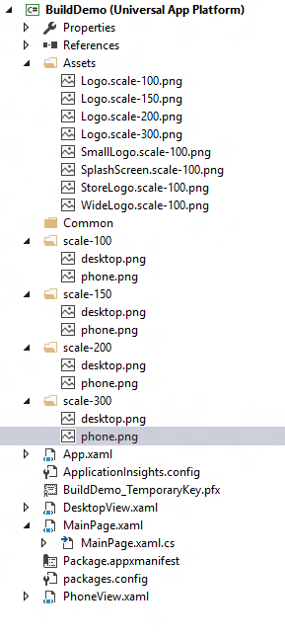
How to add and reference scale resources

Slide 30
Add a new resource with .scale-xxx

Slide 31
Add a new scale resource folder

Slide 32
Reference resources with a URI, leaving out the "scale-xxx". The platform does the rest for you.
"ms-appx:///Assets/Logo.png"
"ms-appx:///desktop.png"

Slide 33
An image tag in XAML could look like this:

Slide 34
Developer considerations
Hardware
Adaptive Apps
Packaging
Scaling
Multi-screen
Integral

Slide 35
Take advantage of the phone and big screen simultaneously

Slide 36
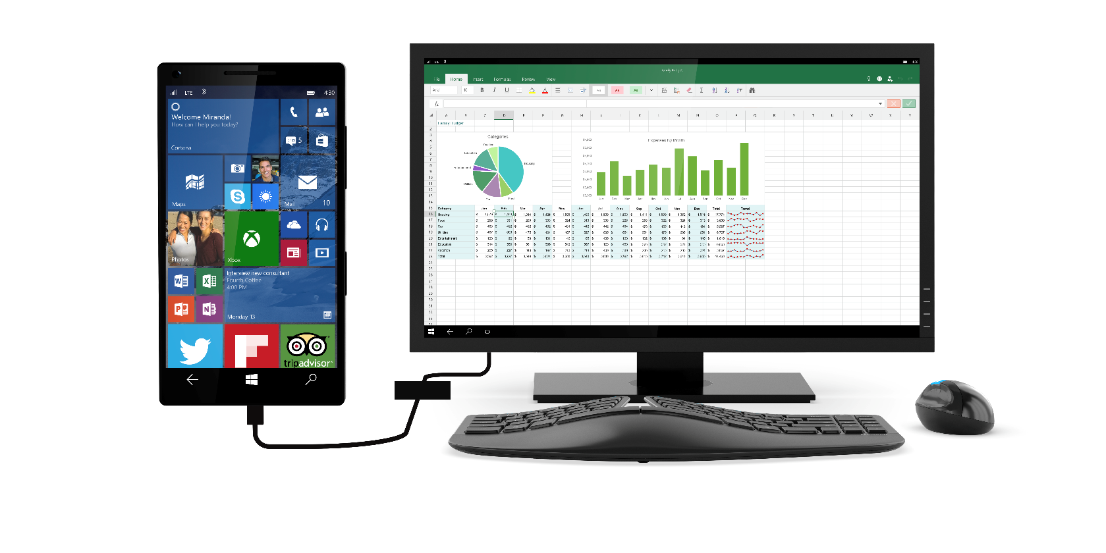

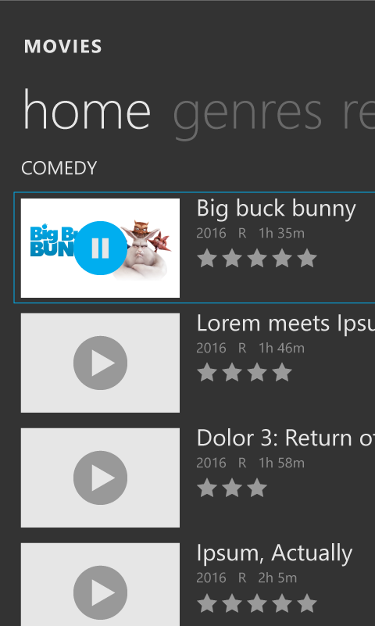
Cast API

Slide 37
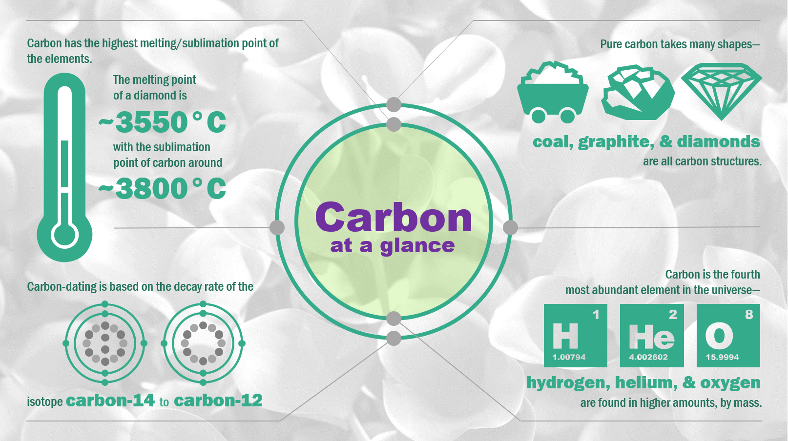
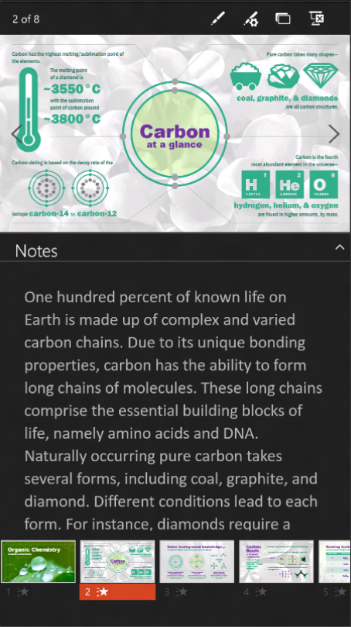
ProjectionManager API

Slide 38
private async void StartProjecting_Click(object sender, RoutedEventArgs e)
{
//Check whether there is already active connection to an external display
if (ProjectionManager.DisPlayAvailable)
{
int thisViewId;
thisViewId = ApplicationView.GetForCurrentView().Id;
var thisDispatcher = Window.Current.Dispatcher;
await CoreApplication.CreateNewView().Dispatcher.RunAsync(CoreDispatcherPriority.Normal,()=>
{
// Display the page in the view. Not visible until "StartProjectionAsync" called
var rootFrame = new Frame();
rootFrame.Navigate(typeof(ProjectionViewPage), initData);
Window.Current.Content = rootFrame;
Window.Current.Activate();
});
// Show the view on a second display
await ProjectionManager.StartProjectingAsync(rootPage.Id, thisViewId);
}
}
private async void StopProjecting_Click(object sender, RoutedEventArgs e)
{
await ProjectionManager.StopProjectingAsync(rootPage.ProjectionViewPageControl.Id, thisViewId);
}

Slide 39
private async void StartProjecting_Click(object sender, RoutedEventArgs e)
{
//Check whether there is already active connection to an external display
if (ProjectionManager.DisPlayAvailable)
{
int thisViewId;
thisViewId = ApplicationView.GetForCurrentView().Id;
var thisDispatcher = Window.Current.Dispatcher;
await CoreApplication.CreateNewView().Dispatcher.RunAsync(CoreDispatcherPriority.Normal,()=>
{
// Display the page in the view. Not visible until "StartProjectionAsync" called
var rootFrame = new Frame();
rootFrame.Navigate(typeof(ProjectionViewPage), initData);
Window.Current.Content = rootFrame;
Window.Current.Activate();
});
// Show the view on a second display
await ProjectionManager.StartProjectingAsync(rootPage.Id, thisViewId);
}
}
private async void StopProjecting_Click(object sender, RoutedEventArgs e)
{
await ProjectionManager.StopProjectingAsync(rootPage.ProjectionViewPageControl.Id, thisViewId);
}

Slide 40
private async void StartProjecting_Click(object sender, RoutedEventArgs e)
{
//Check whether there is already active connection to an external display
if (ProjectionManager.DisPlayAvailable)
{
int thisViewId;
thisViewId = ApplicationView.GetForCurrentView().Id;
var thisDispatcher = Window.Current.Dispatcher;
await CoreApplication.CreateNewView().Dispatcher.RunAsync(CoreDispatcherPriority.Normal,()=>
{
// Display the page in the view. Not visible until "StartProjectionAsync" called
var rootFrame = new Frame();
rootFrame.Navigate(typeof(ProjectionViewPage), initData);
Window.Current.Content = rootFrame;
Window.Current.Activate();
});
// Show the view on a second display
await ProjectionManager.StartProjectingAsync(rootPage.Id, thisViewId);
}
}
private async void StopProjecting_Click(object sender, RoutedEventArgs e)
{
await ProjectionManager.StopProjectingAsync(rootPage.ProjectionViewPageControl.Id, thisViewId);
}

Slide 41
private async void StartProjecting_Click(object sender, RoutedEventArgs e)
{
//Check whether there is already active connection to an external display
if (ProjectionManager.DisPlayAvailable)
{
int thisViewId;
thisViewId = ApplicationView.GetForCurrentView().Id;
var thisDispatcher = Window.Current.Dispatcher;
await CoreApplication.CreateNewView().Dispatcher.RunAsync(CoreDispatcherPriority.Normal,()=>
{
// Display the page in the view. Not visible until "StartProjectionAsync" called
var rootFrame = new Frame();
rootFrame.Navigate(typeof(ProjectionViewPage), initData);
Window.Current.Content = rootFrame;
Window.Current.Activate();
});
// Show the view on a second display
await ProjectionManager.StartProjectingAsync(rootPage.Id, thisViewId);
}
}
private async void StopProjecting_Click(object sender, RoutedEventArgs e)
{
await ProjectionManager.StopProjectingAsync(rootPage.ProjectionViewPageControl.Id, thisViewId);
}

Slide 42
private async void StartProjecting_Click(object sender, RoutedEventArgs e)
{
//Check whether there is already active connection to an external display
if (ProjectionManager.DisPlayAvailable)
{
int thisViewId;
thisViewId = ApplicationView.GetForCurrentView().Id;
var thisDispatcher = Window.Current.Dispatcher;
await CoreApplication.CreateNewView().Dispatcher.RunAsync(CoreDispatcherPriority.Normal,()=>
{
// Display the page in the view. Not visible until "StartProjectionAsync" called
var rootFrame = new Frame();
rootFrame.Navigate(typeof(ProjectionViewPage), initData);
Window.Current.Content = rootFrame;
Window.Current.Activate();
});
// Show the view on a second display
await ProjectionManager.StartProjectingAsync(rootPage.Id, thisViewId);
}
}
private async void StopProjecting_Click(object sender, RoutedEventArgs e)
{
await ProjectionManager.StopProjectingAsync(rootPage.ProjectionViewPageControl.Id, thisViewId);
}

Slide 43
Demo: Multi-screen
Notes:
Show ppt

